Slide 1
GridPort: Using Globus for Grid-Enabled Web Portals
Tomislav Urban
Texas Advanced Computing Center

Slide 2
Outline
Why GridPort?
GridPort 2.x
Motivations for GridPort v3.0
Technical Approach for GridPort 3.0
GridPort 3 Status, Future and Conclusions

Slide 3
Premise
‘Upper middleware’ can and should be introduced between the low-level grid services offered by systems such as Globus and the presentation layer.
This layer can fundamentally transform the ease and speed with which user-interface developers can bridge the gap between end-users and a grid.

Slide 4
Main GridPort Design Goals
API Aggregation
  Provide single, integrated, high-level API spanning comprehensive set of low-level grid services. Avoid multiple, “stove-pipe” front-end solutions
API Simplification
  Providing simple API geared towards User Interface developers
Functionality not available in other products
  Provide missing lower-level services needed for portals, apps
  Provide higher-level services built on lower-level building blocks
Archival services via GPIR
  Provide central, easy-to-access data store for grid data needed by portals/apps including historical data on usage, performance.
(Also as needed:
  Provide additional, necessary low-level services needed for portals/apps not provided by other lower-level services. Eliminate these bits as they are provided by Globus, NWS, etc.)

Slide 5
Current: GridPort 2.3
Implemented in Perl
“Services:”
  Authentication/MyProxy
  Information Services (status, loads, queues, etc.)
  Job Submission
  File Transfer
  Data Access (SRB)
Approach
  Easy to install (Perl, little or no server side config)
  Light-weight
Many current production portals…

Slide 6
Current Status of GridPort 2.x
GridPort 2.x is available for download
  URL: https://gridport.npaci.edu/
Many portals are using v2.x in production
  NPACI and PACI HotPage
  TACC User Portal
  Telescience Portal
  Ex4
  Ex5
  Ex6
GridPort 2.x is included in NPACKage
  URL: http://npackage.npaci.edu/

Slide 7
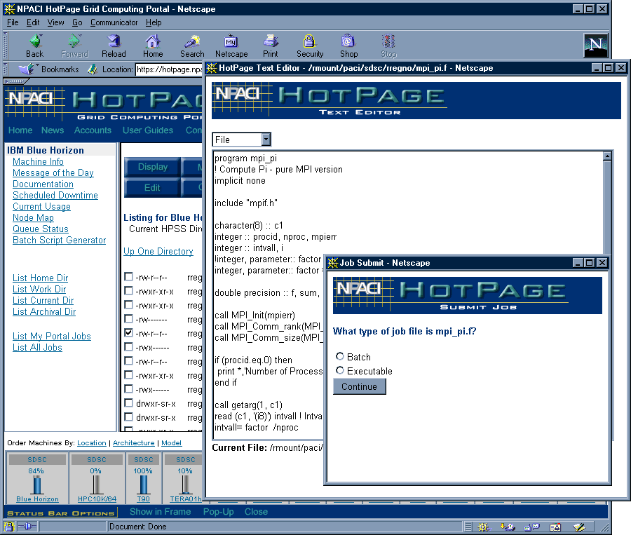
NPACI HotPage

Slide 8
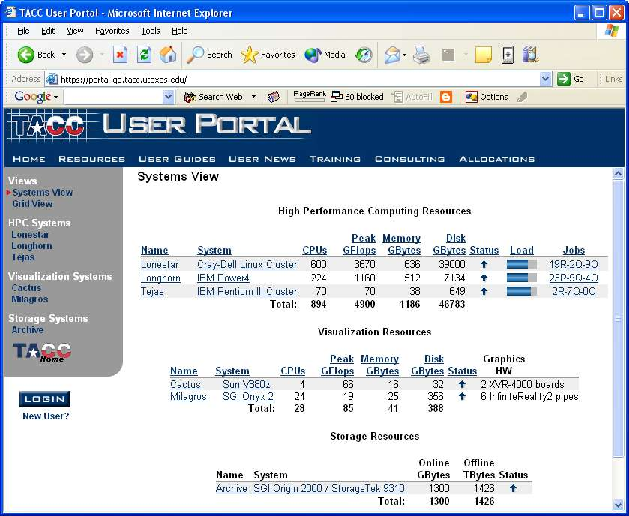
TACC User Portal

Slide 9
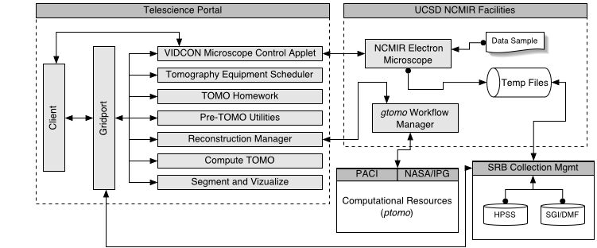
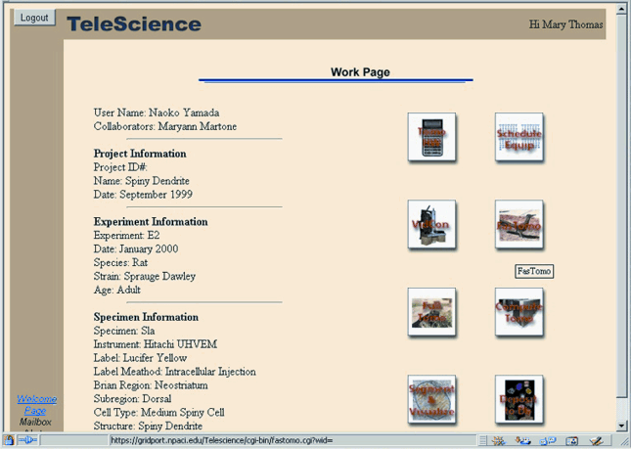
Telescience: Access to Instruments/Data
Uses GridPort to Integrate Telescience technologies with the Grid
  Access to instruments
  Globus job control
  SRB data collections
Migrating to BIRN

Slide 10
Fusion Grid Portal
GT2.x
GP2.x
Java CoG
SRB
Jetspeed Based Portal
Fusion Grid Portal
(Apache, Jetspeed)
Portlet
Components
Portal
Web Services
Fusion
Monitor
System
Fusion Grid
Shell
MDS+
Viewer
Analysis/
Applications
EFIT
EQDISK
Grid Portal
Catalogue
User
Data
GRID
Web
Services
GRID
S/W
MDS+
Collection/
Archive
SRB/
MCAT
Plasma
Shot
DAS

Slide 11
Motivation for GridPort v3.0

Slide 12
Motivation for Next Release
Requirements Evolution
Technology Evolution

Slide 13
Requirements Evolution
Larger user community (more communities)
  NPACI
  Campus Grid (UT Grid)
  SciDAC/DOE (Fusion Grid)
  DoD
  State of Texas Grid (TIGRE)
  NMI Testbed
  Other Collaborations
Drives the need to support multiple VOs from a single GridPort instance with improved scalability and multi-portal management

Slide 14
Requirements Evolution
Highly Distributed Users and Resources
  Drives the need to make GridPort services accessible over Web/Grid services
Intelligent Workflow
  Web Services based workflow
  Need the ability to automate typical use scenarios, job submission, file movement, visualization, etc.
Distributed Visualization
  Remote use of powerful rendering resources
  Viewing incremental results during simulations
  Collaborative visualization
  Computational steering

Slide 15
Requirements Evolution
Data
  Grid Meta Data
  The need for comprehensive grid meta-data including VO-Resource-Site relationships, not just Job and Load data
Data Collection Access
  Integrate file and data collection access into GridPort
  Meta-data cataloguing system integration supported under GP2.x will be extended for GP3.0 (e.g. SRB or MCS)

Slide 16
Requirements Evolution
Generalized Grid Computing Environments (GCEs)
Application Profiling
  Need to enable the retention of run parameters across multiple Job runs
Advanced Scheduling
  Integration with one or more Grid Meta-schedulers
    e.g. CSF
More Sophisticated User Interfaces
  Expanded Client Types
    Portals, PDAs, Shells (Command Line Interface)

Slide 17
Technology Evolution
Many technological changes since original GridPort was conceived:
  OGSI/OGSA
    GT3.0
  XML
  Java
    J2EE
  Jetspeed/Portlets
Existing technologies that were not exploited in the original GridPort:
  RDBMS

Slide 18
‘High-level Middleware’ Role
There is a lot of work being conducted in the space above low level grid software (e.g. Globus), and up to (and including) the presentation (portlets and portals).
This suggests a distinction between “high” and “low” level grid services
“High-level” middleware addresses:
  the need to abstract low-level services (e.g. Globus)
  integration of various Grid services under a uniform API (SRB, NWS, Globus, etc.)
  service coordination (i.e. scheduling and workflow)
  user centric services
    personalization (e.g. “My Jobs”, “My Applications”, etc.)
    single sign-on
    authorization

Slide 19
Technical Approach for GridPort 3.0

Slide 20
Grid Middleware Architecture
Two possible philosophies:
  Layer Approach
    Introduce a layer between low-level grid services and presentation
    Handles most or all business logic
    Coordinates inter-service flow
    Provides common services and centralized persistence
    May cause dependencies
  Collection of services
    Each service talks directly to low-level grid services
    May need to provide its own configuration and persistence mechanisms
    Each service remains independent and standalone

Slide 21
UI
UI
Expanded support for a variety of UI clients
  Thin Client
    Browser
  Thick Client
    Desktop Application (Client-Server)
  Command Line
    GCE Shell
  PDAs
  Functionality must be available beyond the portal framework
Applications / Portals / Portlets
GridPort
(Service Aggregation,
Workflow)
OGSA Services
OGSI (GT3)
OS
Resources

Slide 22
Presentation
UI
This layer is reduced largely to presentation issues with GridPort or other “high-level” middleware driving most application logic
Current focus is on Portlet technologies.
Some Portlets may talk directly to low-level services
Applications / Portals / Portlets
GridPort
(Service Aggregation,
Workflow)
OGSA Services
OGSI (GT3)
OS
Resources

Slide 23
GridPort
UI
Workflow – interaction between OGSA Service components
Component Approach
  need robust OO design → Java
RDBMS for persistence
Goal is to present the Application/Portal developer with a simple unified API and built-in Application Logic (e.g. Workflow) to speed and aid rapid development
Applications / Portals / Portlets
GridPort
(Service Aggregation,
Workflow)
OGSA Services
OGSI (GT3)
OS
Resources

Slide 24
Backend
UI
Distributed grid and web services (OGSA)
Will support
  Security (GSI)
  Job Submission (GRAM)
  Scheduling (LSF)
  Community Scheduling Framework (CSF)
  Data Access (SRB)
Awaiting standards from GGF (OGSA-WG)
Applications / Portals / Portlets
GridPort
(Service Aggregation,
Workflow)
OGSA Services
OGSI (GT3)
OS
Resources

Slide 25
J2EE
GridPort 3.0 is built on top of J2EE, leveraging the significant benefits of the J2EE platform
  Using Spring (http://www.springframework.org) J2EE framework to ease to simplify our use of J2EE while maximizing the advantage that we can take of the platform.

Slide 26
Grid Services
Will be exposed as OGSI compliant Grid Services for remote access
GridPort 3 services are currently accessed through a Java API in order to ease scalability and performance concerns
  Use local direct calls where possible, Grid or Web Service calls only where necessary
Notes:
Expose application components both directly and via grid/web services where possible, maximize the flexibility of client access.

Slide 27
Core Services
GridPort’s API will make the traditional “core” services available:
  Authentication/MyProxy
  Information Services (status, loads, queues, etc.)
  Job Submission
  File Transfer

Slide 28
GPIR
All data supporting portal development will be cached in GPIR
This data may come from a variety of sources, or be produced internally
GPIR is simply GridPort’s persistence mechanism, though it too is exposed as a web service
GPIR focuses on multi VO Grid metadata
Will be used to cache user sessions for “statefullness” across multiple portal visits

Slide 29
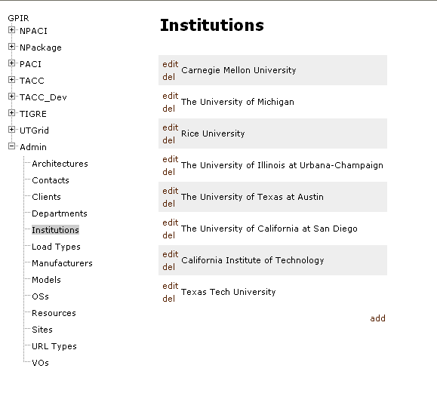
GPIR Admin Client
Allows simple updates to data that is not obtained programmatically
Streamlines creation of VOs, addition and maintenance of resources
Build as a standard JSP-based J2EE application

Slide 30
CSF
Will utilize the Community Scheduling Framework as a grid scheduler
GridPort supports
  the submission of jobs to CSF
  the retrieval of job status, target resource, etc. from RIPS (Resource Information Provider Service)
Looking forward to the creation of more sophisticated scheduling plug-ins for CSF
  TACC is participating in this effort with Platform Computing

Slide 31
Job Sequencer
Very simple “Macro” capability
Limited to serial tasks consisting of CSF Job Submission and GridFTP file transfers
While simple, addresses a large percentage of typical usage scenarios
  Stage files, run computation, move file to Visualization resource

Slide 32
Shift in Approach
The use of J2EE, DBMS, and Java represent a significant shift away from the light-weight approach of the Perl-based GridPort 2.x
Significant server-side resources now required
Significant increase in complexity
This is mitigated by the availability of GridPort though a web/grid services interface
Suggests two tiers of GridPort users
  User of an existing GP installation for a VO
  As currently, installation of one’s own GridPort instance
“Simple and practical”, remains the basic approach

Slide 33
Current Status and Future Work
Currently have prototype complete, looking for release in Q1 2004
Port to GT3.2
Provide User-centric features such as My Jobs view and Job Submission history
Integration with GridFlow, GridSteer
Development of a web-based Administrative Client currently in development

Slide 34
Conclusion
Bottom line:
GridPort aggregates core grid services in the interest of presenting simple, powerful and streamlined access to backend grid services and higher-order workflow to UI developers (Portals, Portlets, Shells, Applications, etc.)
GridPort 3.0 will be of value to
  GridPort 2.x users
  New communities who want to create applications portals on grids

Slide 35
Collaborators
Mary Thomas
Jay Boisseau
Maytal Dahan
Akhil Seth
David Walling
Eric Roberts

